Slide 1

LOVELY PROFESSIONAL UNIVERSITY
PHAGWARA, PUNJAB
PRESENTATION FOR SUMMER TRAINING PROJECT
Made by-ROSHAK KUMAR
REGNO--12203460

Slide 2

R PROGRAMMING

Slide 3


Slide 4

INTRODUCTION
R is an open-source programming language that is widely used as a statistical software and
data analysis tool.R generally comes with the Command-line interface. R is available across
widely used platforms like Windows, Linux,and macOS. Also, the R programming language
Is the latest cutting-edge tool.
It was designed by Ross Ihaka and Robert Gentleman at the University of Auckland,
New Zealand, and is currently developed by the R Development Core Team. R programming
language is an implementation of the S programming language.
R programming is used as a leading tool for data analysis. Objects, functions, and packages
Can easily be created by R. It’s a platform-independent language. This means it can be applied
to all operating system.
R is currently one of the most requested programming languages in the Data Science job market
that makes it the hottest trend nowadays.

Slide 5

Why R?
Free installation
Integrate with other languages
Latest cutting edge technology
Platform independent

Slide 6
ABOUT PROJECT
PROJECT NAME-Analysis and prediction of airbnb listing prices
PLATFORM-BOARD INFINITY
The analysis and prediction of Airbnb listing prices is a fascinating and practical application of data science and statistical modelling. As the popularity of airbnb and other short-term rental platforms continues to grow ,understanding the factor that influence listing prices and being able to predict those prices accurately becomes crucial for both hosts and guests. In this project I have used the R programming language to analyse airbnb listing data, Identify key features that affect pricing and build predictive models to estimate the prices of new listings..

Slide 7
STEPS
Data importing
Import the airbnb data using readr or other relevant packages.
This may include .csv files and other formats.
Data cleaning and transformation
Use dplyr and tidyr to clean the data and prepare it for analysis.
This may include handling missing values , outliers or errorneous data.
Exploratory data analysis
Use various R functions and packages to explore the data.
This can include summary, statistics, correlations and distributions.

Slide 8
STEP 1
LOAD AND INSPECT THE DATA
Load your dataset using functions like read.csv(), read_excel(), or any other appropriate
function. Once loaded, examine the structure of the dataset using functions like str() and
head()
data <- read.csv("your_data.csv")
str(data)
head(data)
we have to first import the data into R. R is capable of importing data from many different file types and sources using add on packages, such as data from
csv files
excel files
tab delimited files
fixed width files
databases (e.g. mySQL databases)
Eg:- project=read.csv("C:/Users/Dell/Downloads/maindata.csv")

Slide 9
Different formats to read
To install default R datasets
Just install a package called datasets
Read an R datasets
These are datasets created in R and saved with a .RData extension. R saves the data in a binary format.
load(‘dataset name.RData')
Read a text file
The read.table( ) function will read most text files into your R session.
read.table(‘dataset name.txt', header = TRUE, sep = ",")
This function has three arguments. The first argument identifies the name of the file that you want to read into R enclosed in quotes. The second argument tells the function that your file has a header. The third argument tells the function what symbol is used to separate the data elements
Read a csv file
read.csv("C:/Users/Dell/Downloads/maindata.csv")
Other input files type
There are several variations of read.___( ) that can read specialized file formats such as dcf, fwf [fixed-width format], and DIF.

Slide 10
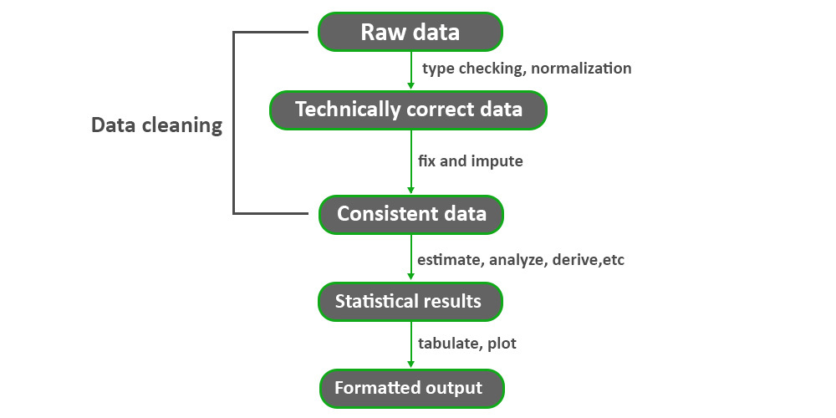
STEP-2
DATA CLEANING AND TRANSFORMATION

Slide 11
Dplyr package
The dplyr package is one of the most popular and powerful packages for data manipulation in R. It provides a set of functions that make it easy to filter, arrange, select, mutate, and summarize data.
Here are some of the key functions provided by the dplyr package:
filter(): Used to subset rows based on specified conditions.
Eg:- filter(data,age > 18)
arrange(): Sorts rows based on specified variables.
Eg:-arrange(data,name)
arrange(data,income,age)
select(): Picks specific columns from a data frame.
Eg:- select(data,contains("a"))
select(data,starts_with("a"),end_with(“i"))
mutate(),transmute(): Adds new variables or modifies existing ones.
Eg:- mutate(data,income=NULL))
t<-transmute(data,increment=income*1.1)
data<-cbind(data,t)

Slide 12
Tidyr package
Tidyr is new package that makes it easy to “tidy” your data. Tidy data is data that’s easy to work with: it’s easy to munge (with dplyr), visualise (with ggplot2 or ggvis).
The two most important properties of tidy data are:
Each column is a variable.
Each row is an observation.
To tidy messy data, you first identify the variables in your dataset, then use the tools provided by tidyr to move them into columns. tidyr provides three main functions for tidying your messy data: gather() , separate() , spread().
gather() function: It takes multiple columns and gathers them into key-value pairs.
gather(data, key = “key”, value = “value”, …, na.rm = FALSE, convert = FALSE, factor_key = FALSE)
separate() function: It converts longer data to a wider format. The separate() function turns a single character column into multiple columns.
separate(data, col, into, sep = ” “, remove = TRUE, convert = FALSE)

Slide 13
mean(airquality$Solar.R)
HANDLING MISSING VALUES IN R
To handle the missing value we will check the columns of the datasets, if we found some missing data inside the columns then this generates the NA values as an output, which
can be not good for every model. So let’s check it using mean() methods.
For example-mean(dataset name$column name)
If NA values are present in that particular column then it will give <NA> as output.
Handling NA value using na.rm in both columns.
For example—mean(dataset name$column name,na.rm=TRUE)
It will give us mean value of the column even if NA values are present in the column
We can also check NA values by the summary of the dataset.
For example—summary(dataset name)
It will give number of NA values present in the particular column of the dataset.

Slide 14
OUTLIERS DETECTION
An outlier is a value or an observation that is distant from other observations, that is to say,
a data point that differs significantly from other data points
Several methods to detect outliers
Minimum and maximum
Boxplot
Histograms
Percentiles

Slide 15
Boxplot
In project I have used boxplot for the detection of outliers as it is easy to detect outliers with
the help of boxplot and it is easy to eliminate them with the help of percentiles.
In report I have added the screenshots of boxplot of every column possible and then after I have Removed that with the help of high whiskers and lower whiskers, quadrant and percentiles and Make the data outliers free and good for visualization.
higher_whisker<-Q3+1.5*IQR_column name
lower_whisker<-Q1-1.5*IQR_column name
IQR_column name<-IQR(dataset name$column name)
IQR
The IQR() function is used to compute the interquartile range of a given object of numerical values. The interquartile range of these values is a range where 25% on either side is cut off .
Statistically, the interquartile range is the difference between the upper quartile and the lower quartile.

Slide 16

Some common functions of R used in project
summary() function:It is used to generate a summary of the statistical properties of a
data object, such as a data frame, matrix, or numeric vector.
cbind() stands for "column bind". It combines objects by columns.
rbind() stands for "row bind". It combines objects by rows
mean() is a measure of central tendency that represents the average value of a dataset.
Min(): can find the minimum value of a vector.
Max(): can find the maximum value of a vector

Slide 17
PLOTS
Scatter plots are used to visualize the relationship between two continuous variables. Each point
represents an observation with values on both the X and Y axes
Eg:-plot( data$age, data$salary, main = "Scatter Plot", xlab = “age", ylab = “salary“,)
Bar plots are used to display the distribution or frequency of categorical data. They consist of
bars representing different categories.
Eg:-barplot(data$income, names.org=data$name, main = "salary",ylim =c(1,60000),width = data$age,xlab = "income",)
Pie charts are used to display the relative proportions of different categories in a dataset. Each
slice represents a category's share of the whole.
Eg:- pie(data$income,data$name,col=color,init.angle =90)
Histograms are used to display the distribution of a single continuous variable. It divides the
data into bins and shows the frequency of observations in each bin.
Eg:- hist(data$salary, main = "Histogram", xlab = "Value", ylab = "Frequency“, breaks=4)
Box plots are used to display the summary statistics (median, quartiles) of a dataset. They are
especially usefulfor comparing distributions
Eg:-boxplot(data$salary , main = "Box Plot", xlab = "Group", ylab = "Value")

Slide 18
TIBBLE
A tribble is a special type of data frame in R, particularly useful for creating small datasets directly in your code. It's part of the package tibble.
Pipeline Operator %>%
The pipeline operator allows you to chain together a sequence of operations in a more readable and efficient way.
Eg:- total <- upload%>%mutate(outoff=90)a
final_result<-total %>% arrange(name,marks,outoff)

Slide 19
THANK YOU

